Slide 1
Early Sepsis Prediction
The Erdős Institute Deep Learning Bootcamp, Fall 2025
Yang Mo, Sayantan Sarkar, Cristopher Thompson, Alexandria Wheeler

Slide 2
Table of contents
01.
05.
02.
06.
03.
07.
04.
Introduction
Deep Learning Models
Dataset Preprocessing
Final Model/ Results
Exploratory Data Analysis
Future Work
Baseline Model

Slide 3
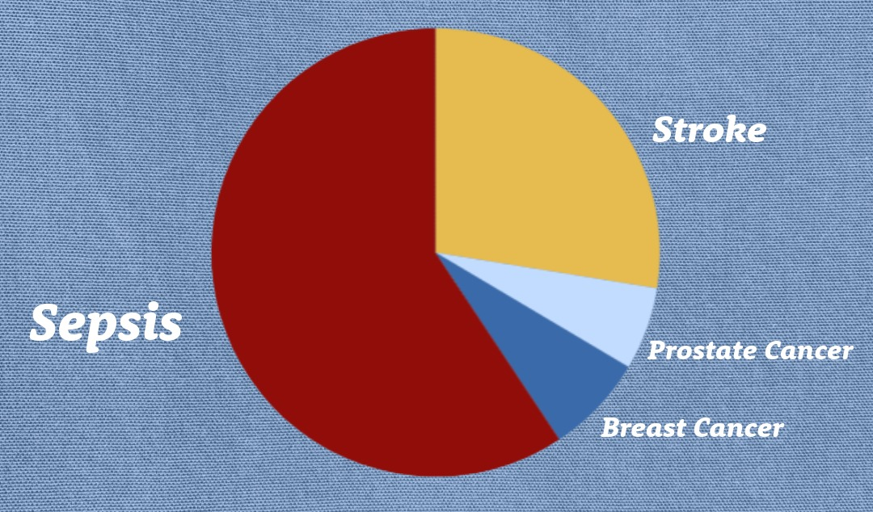
Sepsis: A Critical Healthcare Crisis
Leading cause of death in US hospitals
1.7M cases, ~350K deaths annually in U.S.
$24B annual healthcare cost
Every hour of delay: 4-9% mortality increase
Our Goal: Deep learning model for early ICU sepsis detection

Slide 4
Exploratory Data Analysis
Dataset:
40,000+ ICU patients from 2 hospitals
Hourly time-series: 40 clinical variables + demographics
e.g.: HR, temp, potassium levels, age, gender
Key Challenges:
Severe class imbalance:
7% sepsis rate
Massive scale:
1.4M+ hourly records
Lots of missing values:
~20% data density

Slide 5
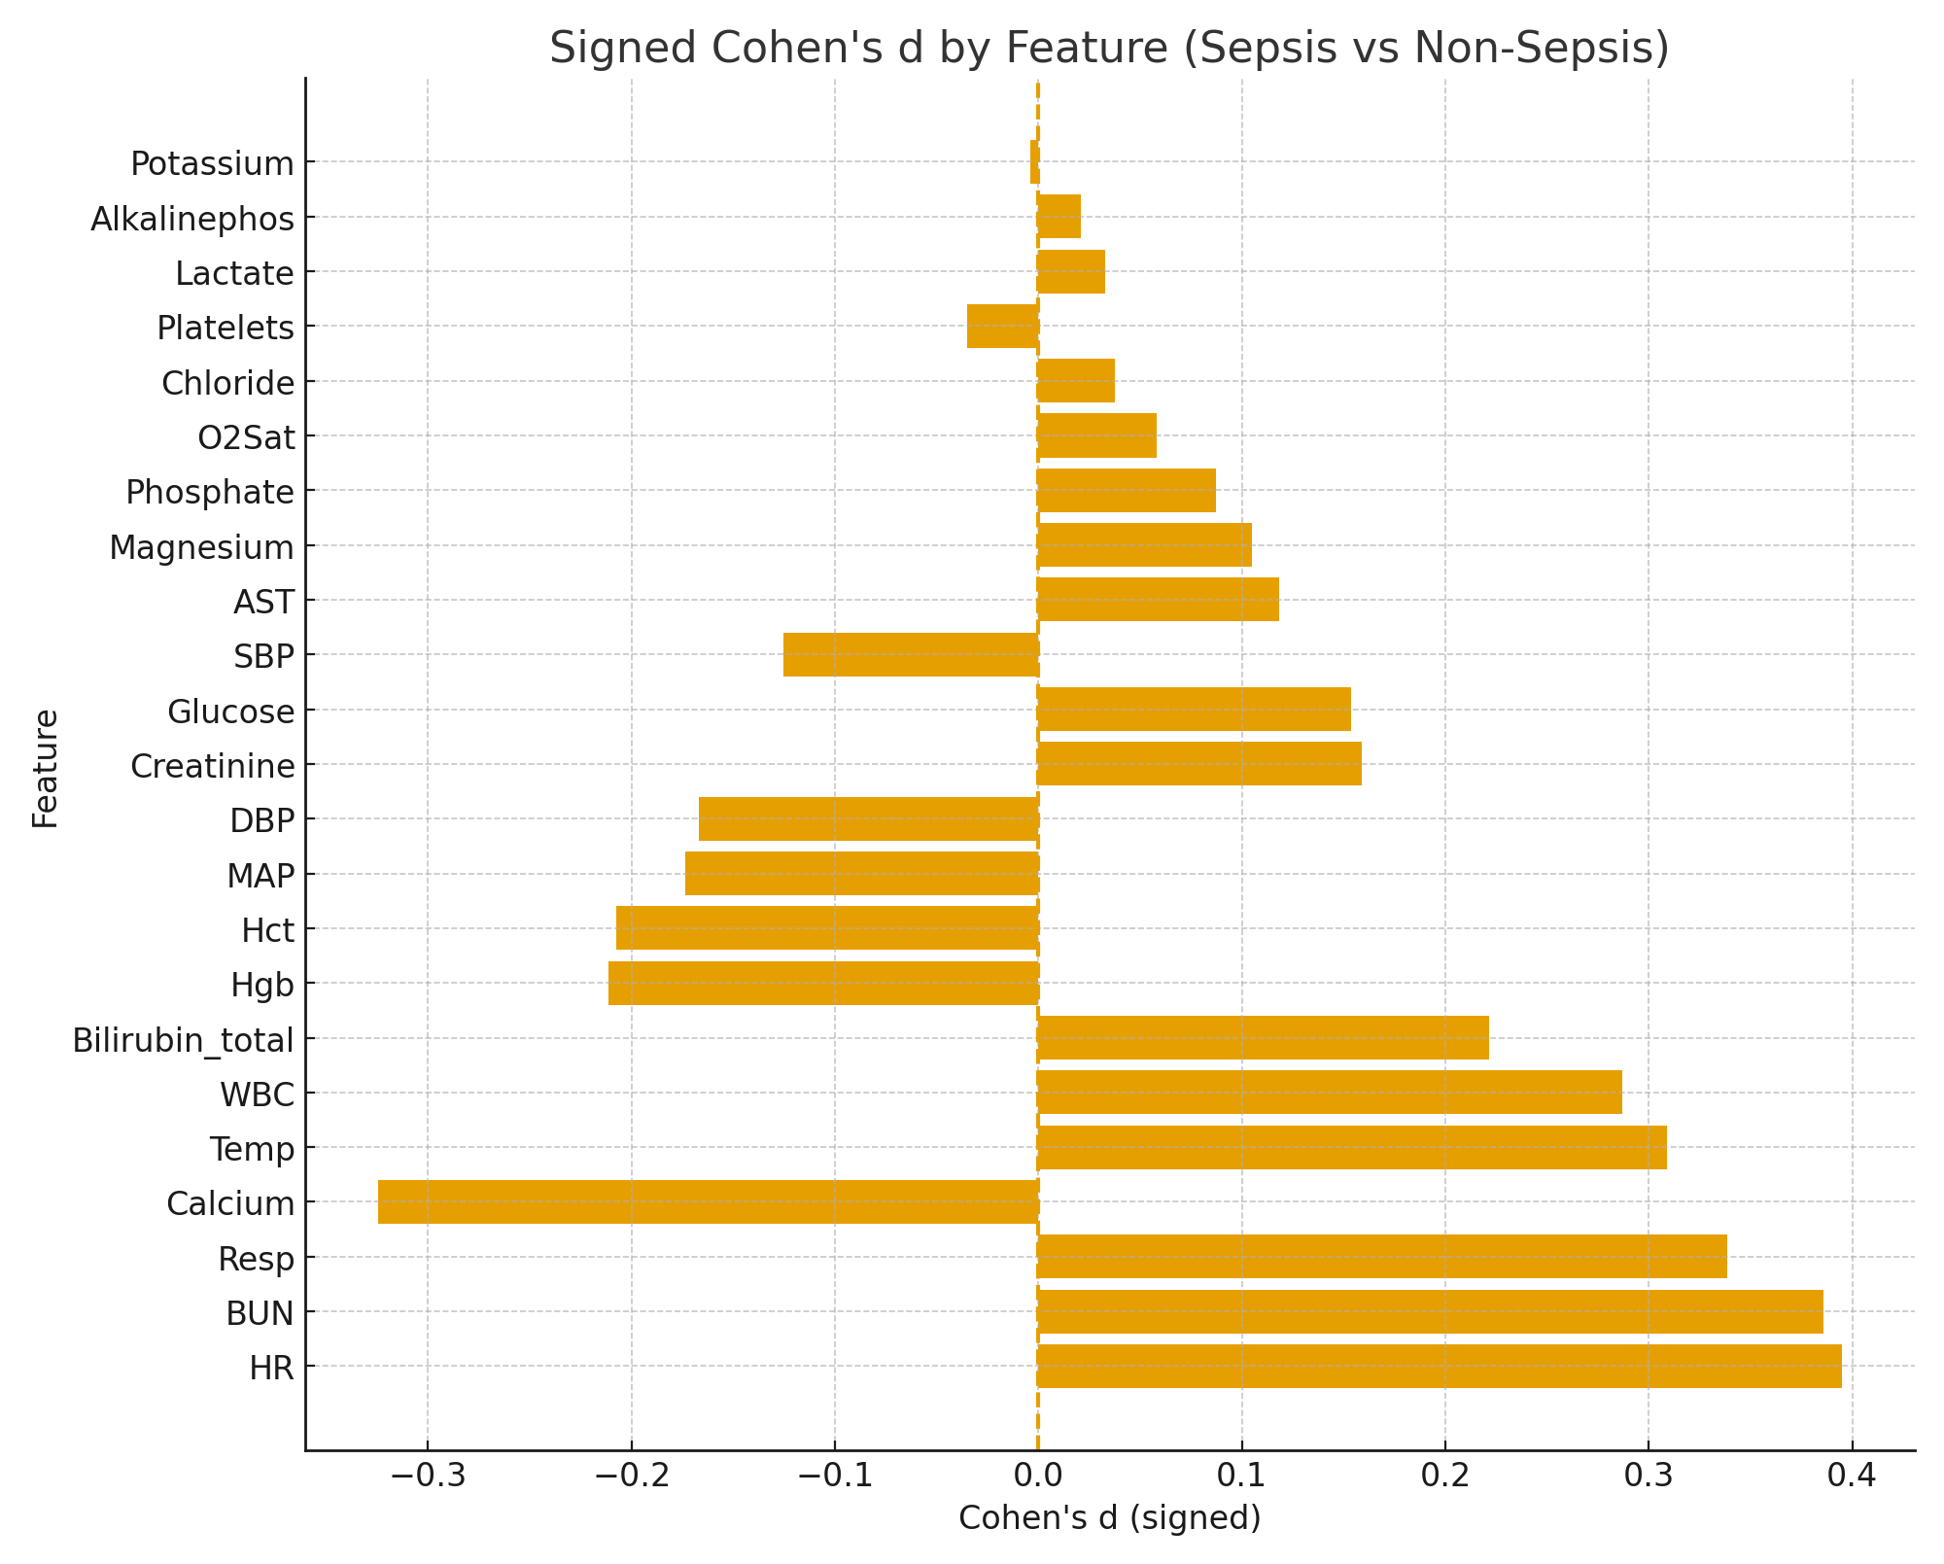
Exploratory Data Analysis
Cohen’s d measures how far apart two group means are.
|d| < 0.2: negligible; 0.2–0.5: small; 0.5–0.8: moderate; ≥ 0.8: large.
Separation is small but consistent across several vitals/labs
Top separators (by |d|) highlight HR, BUN, Resp, Calcium, Temp
Positive d ⇒ higher in septic; negative d ⇒ higher in non-septic

Slide 6
Data Preprocessing
For very less sparse features (like temp) we used linear interpolation.
Missingness handled via KNN imputation Iterative/Model-based imputation (RandomForest) where applicable.
Outliers capped (winsorization) to enforce physiologic plausibility.
Standardization/scaling applied; explicit missingness masks created for analysis/modeling.
The data were padded and masked to align variable-length time series for deep learning input.

Slide 7
Baseline Models
Logistic Regression Baseline:
Fast training/prediction
Test AUROC: 66%
Precision: 23% | Recall: 1%
Insufficient for clinical use
KNN with DTW:
Could not scale to large dataset
Poor performance due to class imbalance

Slide 8
Deep Learning Models Explored
Notes:
We decided to test out 3 separate deep learning models. We will choose the best model based on performance metrics AUPRC and AUROC

Slide 9
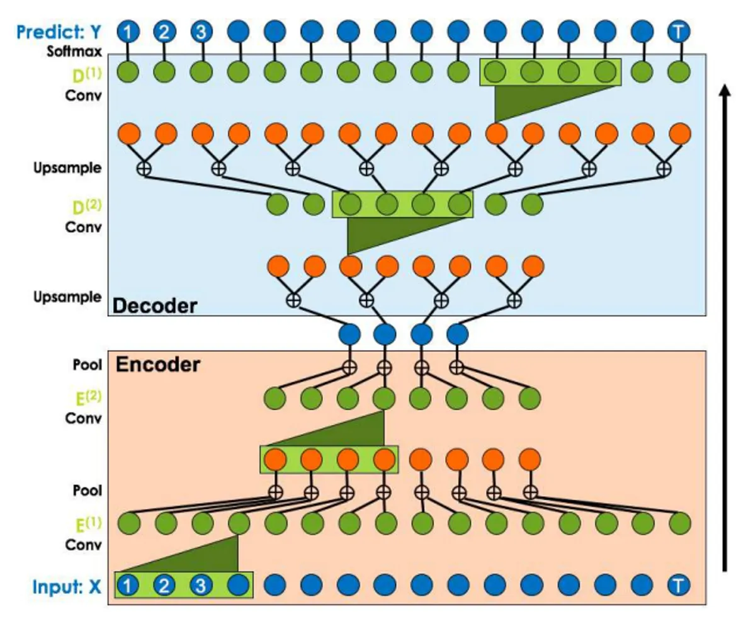
Temporal Convolution Network (TCN)
TCN= 1D CNN + causal convolutions
Performance (on validation data):
train_acc=0.9792 |
| Val loss=0.3226 |
AUROC=0.703 AUPRC=0.151
Not very good because of low AUPRC.
Lea et al. (2016)
Notes:
Yang: TCN stands for temporal convolution neural network. As the name suggests, it is modified one dimensional convolution neural network that preserves casual relation to avoid future leakage. On the validation data, we achieved 70% AUROC but only 15.1% AUPRC, which means there are so many false positives that it is just slightly better than pure guessing.

Slide 10
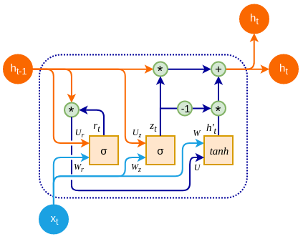
GRU- D
Gated Recurrent Unit with Decay: a deep learning model for irregular and missing time series data.
Designed specifically for medical time series like ICU data, where sampling is irregular and values are often missing.
Learns temporal changes and missingness patterns that reveal rare events early, rather than relying on frequency of labels- thus is very useful when there is a class imbalance.
courtesy

Slide 11
Patient-level
AUROC = 0.82
AUPRC = 0.51
@ threshold = 0.24
Precision = 0.53
Recall = 0.41
@ recall ≥ 0.90, threshold = 0.03 → Recall = 0.88

Slide 12
Temporal Residual Transformer (TRT)
Model Design – Temporal Residual Transformer (TRT): A deep learning model that uses two Transformer Encoder blocks with 4-head self-attention, 256-dimensional feed-forward layers, and residual connections.
Epoch [20/20] | Train Loss: 0.3541 | Val Loss: 0.4449, Acc: 0.8400, Prec: 0.2734, Rec: 0.7248, AUC: 0.8793

Slide 13
Final Model/Results
Model selected: Temporal Residual Transformer (TRT)
--- Test Set Evaluation ---
Test Loss: 0.4401 Test Accuracy: 0.8351 Test Precision: 0.2717 Test Recall (Sensitivity): 0.7554 Test F1 Score: 0.3997 Test AUROC: 0.8802 Test Avg Precision (AUPRC): 0.5543

Slide 14
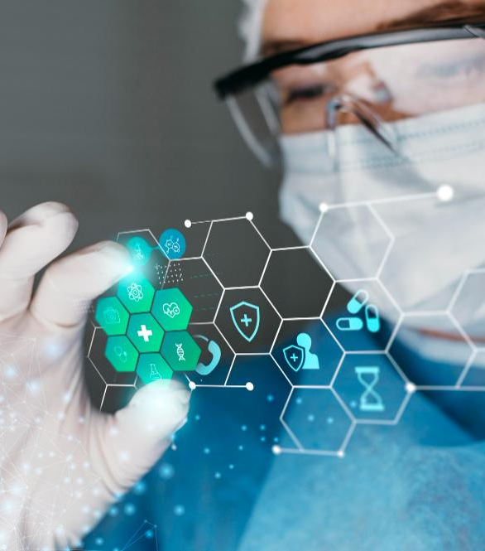

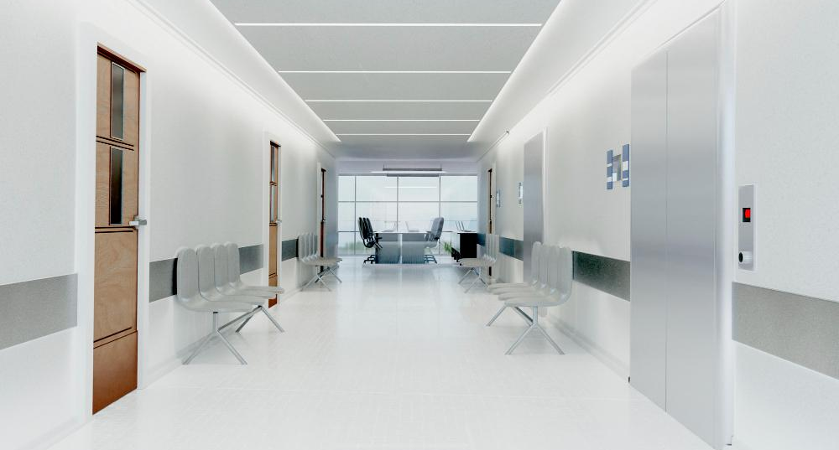
Future Goals
Improve the model to where it can predict the hour in which the patient gets sepsis.
Compare hospitals A and B to see if there is a difference.
Continue to further improve the model’s accuracy.

Slide 15
95%
Mercury is the closest planet to the Sun and the smallest one in the Solar System—it’s only a bit larger than the Moon

Slide 16
Six ideas
Neptune
Saturn
Neptune is the farthest planet from the Sun. It's also the fourth-largest planet by diameter
Saturn is a gas giant and has rings. It's composed mostly of hydrogen and helium
Venus
Mars
Venus has a beautiful name and is the second planet from the Sun. It’s terribly hot
Despite being red, Mars is actually a cold place. It's full of iron oxide dust, its reddish cast
Earth
Jupiter
Earth is the third planet from the Sun and the only one that harbors life in the Solar System
Jupiter is a gas giant and the biggest planet in the Solar System. It's the fourth-brightest object

Slide 17
Contents of this template
You can delete this slide when you’re done editing the presentation
Fonts | To view this template correctly in PowerPoint, download and install the fonts we used
Used and alternative resources | An assortment of graphic resources that are suitable for use in this presentation
Thanks slide | You must keep it so that proper credits for our design are given
Colors | All the colors used in this presentation
Icons and infographic resources | These can be used in the template, and their size and color can be edited
Editable presentation theme | You can edit the master slides easily. For more info, click here
For more info: SLIDESGO | BLOG | FAQs
You can visit our sister projects: FREEPIK | FLATICON | STORYSET | WEPIK | VIDEVO

Slide 18
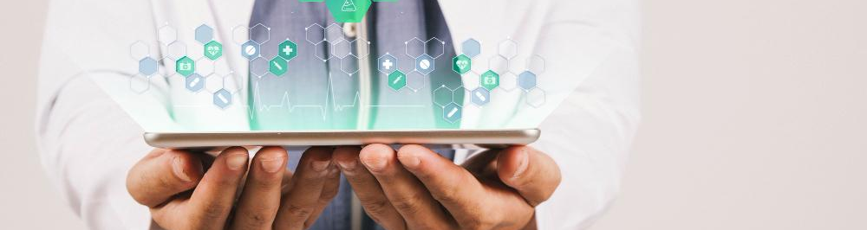
5,000
20,000
50,000
This is the number of transplants performed so far
This is the number of patients we had last month
This is the number of total visitors we had last month

Slide 19
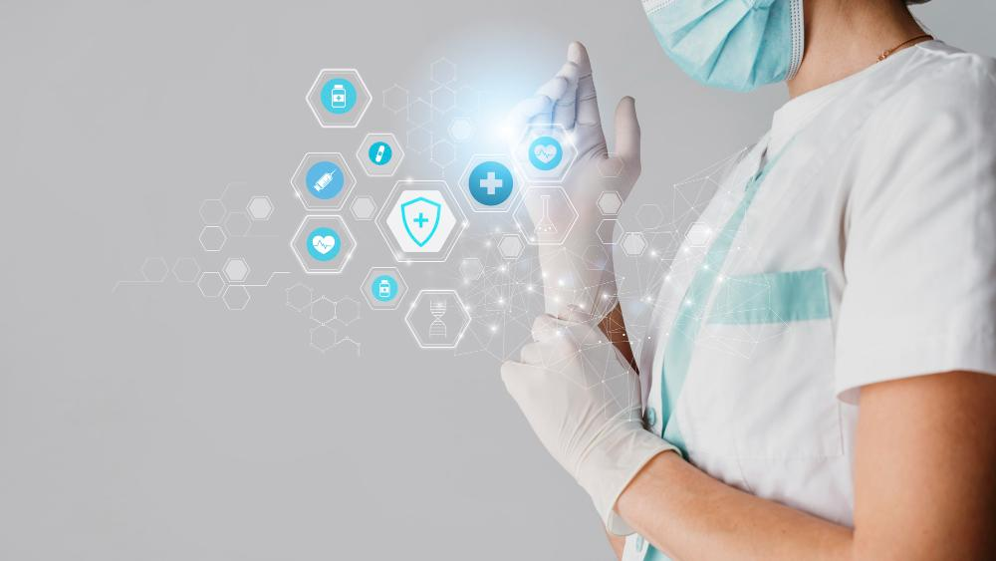
A picture is worth a thousand words

Slide 20
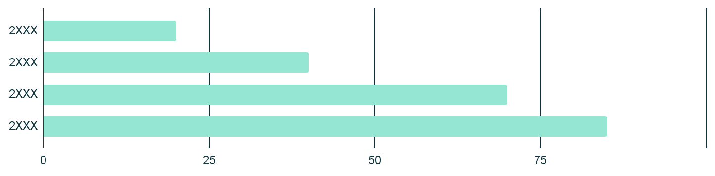
Our statistics
Understanding numbers
Healthcare center statistics refer to the numerical data and metrics that provide insight into the performance, outcomes, and patient demographics of a healthcare facility. These statistics are used to inform decision-making and identify areas for improvement in the delivery of healthcare services
Follow the link in the graph to modify its data and then paste the new one here. For more info, click here

Slide 21
Our plans
Basic plan | Standard plan | Premium plan
$30 | $35 | $40
$312 | $360 | $408
$20-$50 | $15-$40 | $10-$30
Routine checkup Emergency room visit Hospitalization | All of the above Specialist coverage Prescription drugs | All of the above Maternity coverage Mental health coverage
Monthly
Yearly
Special appointments

Slide 22
Milestones reached
Mercury is very small
1.
2.
Venus is very hot
Mars is very cold
4.
3.
Earth has life
Jupiter is big
5.
6.
Saturn is a gas giant
The Moon is a satellite
8.
7.
Neptune is an ice giant

Slide 23

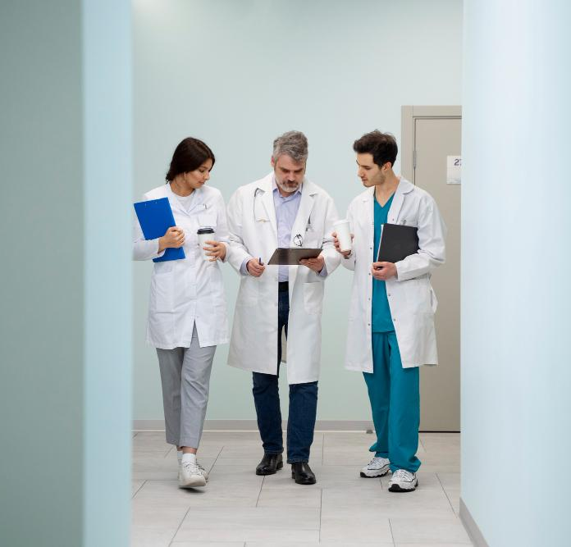
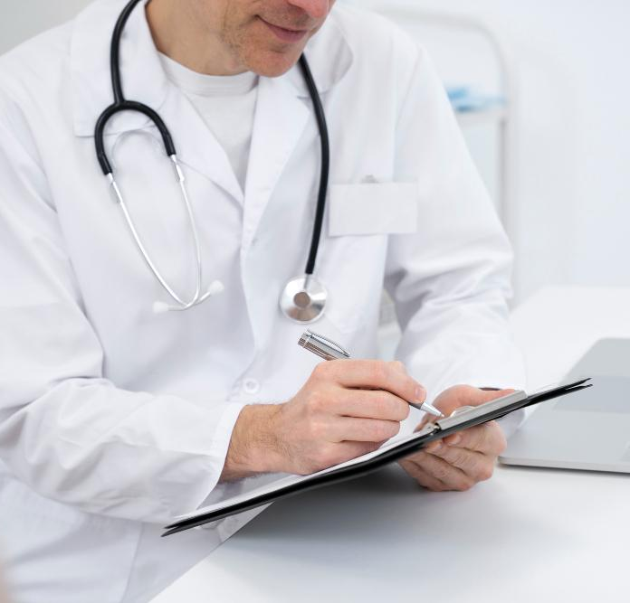
Photo showcase
You can replace the images on the screen with your own work. Just right-click on any of them and select “Replace image”

Slide 24
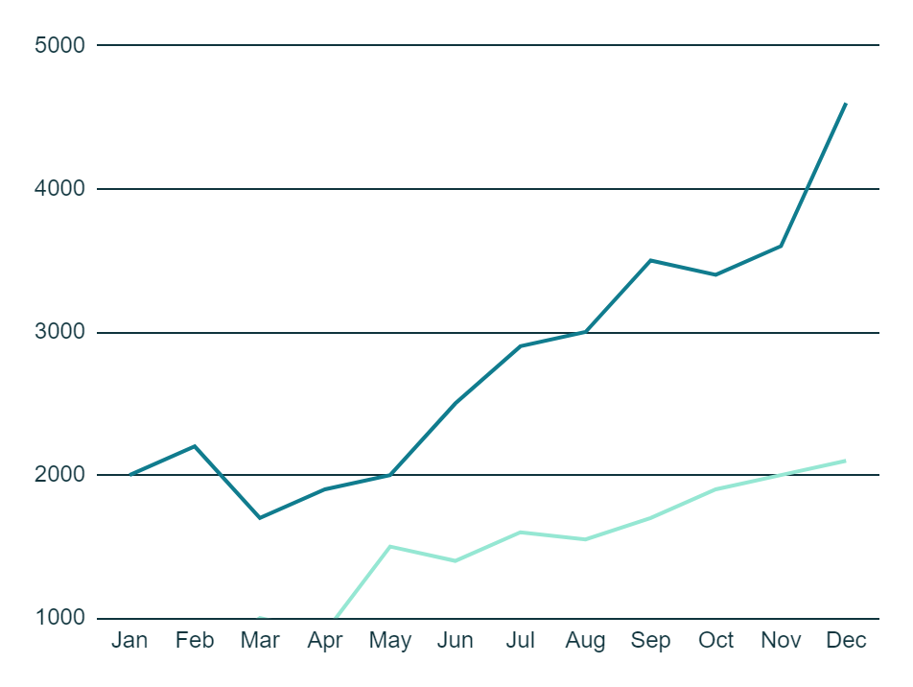
Client experience
Number of patients seen each month
95%
75%
Satisfaction of patients
Would recommend
Mars is red
Venus is hot
Years
2XXX
2XXX
Follow the link in the graph to modify its data and then paste the new one here. For more info, click here

Slide 25

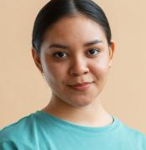
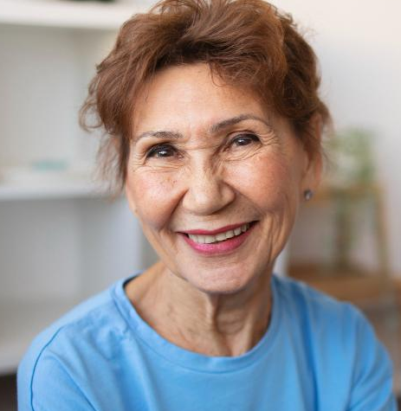
Testimonials
“Mercury is the closest planet to the Sun and the smallest one in the Solar System”
John James, 36
“Neptune is the fourth-largest planet by diameter in the entire Solar System”
“Saturn is the ringed planet. It’s composed mostly of hydrogen and helium”
Jenna Doe, 25
Kate Day, 88

Slide 26


Staff
Specialization and expertise
Dr. Timmy Jimmy
You can enter a description here
You can enter a description here
Role: Medical Director
You can replace the image on the screen with your own
You can enter a description here
You can enter a description here
Specialization and expertise
Sarah James
You can enter a description here
You can enter a description here
Role: Director of Nursing
You can replace the image on the screen with your own
You can enter a description here
You can enter a description here

Slide 27
Thanks
Do you have any questions?
youremail@freepik.com
+91 620 421 838
yourwebsite.com
Please keep this slide for attribution

Slide 28
Icon pack

Slide 29
Alternative resources
Here’s an assortment of alternative resources whose style fits the one of this template:
Vectors
Free vector cyber technology background

Slide 30
Resources
Did you like the resources in this template? Get them at these websites:
Vectors
Free vector gradient data privacy webinar template
Free vector gradient data privacy facebook cover
Icons
Icon Pack: Data Security | Filled

Slide 31
Resources
Did you like the resources in this template? Get them at these websites:
Photos
Free photo medical banner with doctor wearing stethoscope
Free photo medical banner with doctor holding tablet
Free photo empty hallway background
Free photo medical banner with doctor wearing goggles
Free photo medical banner with doctor working on laptop
Free photo medical banner with doctor wearing face mask
Free photo medical banner with doctor and patient
Free photo medical banner with doctor wearing glove
Free photo full shot doctors talking at work
Free photo doctor performing routine medical checkup
Free photo doctor wearing white coat medium shot
Free photo black nurse at their workspace
Free photo doctor helping patient during rehabilitation
Free photo man wearing t shirt gesturing
Free photo senior woman doing exercises at home and spending time with friends

Slide 32
Instructions for use
If you have a free account, in order to use this template, you must credit Slidesgo by keeping the Thanks slide. Please refer to the next slide to read the instructions for premium users.
As a Free user, you are allowed to:
Modify this template.
Use it for both personal and commercial projects.
You are not allowed to:
Sublicense, sell or rent any of Slidesgo Content (or a modified version of Slidesgo Content).
Distribute Slidesgo Content unless it has been expressly authorized by Slidesgo.
Include Slidesgo Content in an online or offline database or file.
Offer Slidesgo templates (or modified versions of Slidesgo templates) for download.
Acquire the copyright of Slidesgo Content.
For more information about editing slides, please read our FAQs or visit our blog:
https://slidesgo.com/faqs and https://slidesgo.com/slidesgo-school

Slide 33
Instructions for use (premium users)
As a Premium user, you can use this template without attributing Slidesgo or keeping the "Thanks" slide.
You are allowed to:
Modify this template.
Use it for both personal and commercial purposes.
Hide or delete the “Thanks” slide and the mention to Slidesgo in the credits.
Share this template in an editable format with people who are not part of your team.
You are not allowed to:
Sublicense, sell or rent this Slidesgo Template (or a modified version of this Slidesgo Template).
Distribute this Slidesgo Template (or a modified version of this Slidesgo Template) or include it in a database or in any other product or service that offers downloadable images, icons or presentations that may be subject to distribution or resale.
Use any of the elements that are part of this Slidesgo Template in an isolated and separated way from this Template.
Register any of the elements that are part of this template as a trademark or logo, or register it as a work in an intellectual property registry or similar.
For more information about editing slides, please read our FAQs or visit our blog:
https://slidesgo.com/faqs and https://slidesgo.com/slidesgo-school

Slide 34
Fonts & colors used
This presentation has been made using the following fonts:
Krub
(https://fonts.google.com/specimen/Krub)
Gothic A1
(https://fonts.google.com/specimen/Gothic+A1)
#315f6a
#ffffff
#0f343d
#d9ffff
#95e7d3
#80e5e1
#5fcac2
#5dc9a7
#a0d4fc
#107c8e

Slide 35





Storyset
Create your Story with our illustrated concepts. Choose the style you like the most, edit its colors, pick the background and layers you want to show and bring them to life with the animator panel! It will boost your presentation. Check out how it works.
Pana
Amico
Bro
Rafiki
Cuate

Slide 36
Use our editable graphic resources...
You can easily resize these resources without losing quality. To change the color, just ungroup the resource and click on the object you want to change. Then, click on the paint bucket and select the color you want. Group the resource again when you’re done. You can also look for more infographics on Slidesgo.

Slide 39
JANUARY
FEBRUARY
MARCH
APRIL
MAY
JUNE
PHASE 1
Task 1
Task 2
PHASE 2
Task 1
Task 2
JANUARY
FEBRUARY
MARCH
APRIL
PHASE 1
Task 1
Task 2

Slide 42
...and our sets of editable icons
You can resize these icons without losing quality.
You can change the stroke and fill color; just select the icon and click on the paint bucket/pen.
In Google Slides, you can also use Flaticon’s extension, allowing you to customize and add even more icons.

Slide 43
Educational Icons
Medical Icons

Slide 44
Business Icons
Teamwork Icons

Slide 45
Help & Support Icons
Avatar Icons

Slide 46
Creative Process Icons
Performing Arts Icons

Slide 47
Nature Icons

Slide 48
SEO & Marketing Icons

Slide 49


